Slide 1
Boosting Regressor Algorithms
Ensemble method
Combines weak learners
Improves prediction accuracy

Slide 2
What is Boosting?
Sequential learning
Focus on errors
Each model improves previous

Slide 3
Popular Algorithms
AdaBoost
Gradient Boosting
XGBoost
LightGBM

Slide 4
AdaBoost Algorithms
AdaBoost (Adaptive Boosting) regression is an ensemble learning method that builds a strong regressor by sequentially combining multiple "weak learners".
In each iteration, it adjusts the weights of training instances based on their prediction error, forcing subsequent models to focus on the most difficult cases

Slide 5
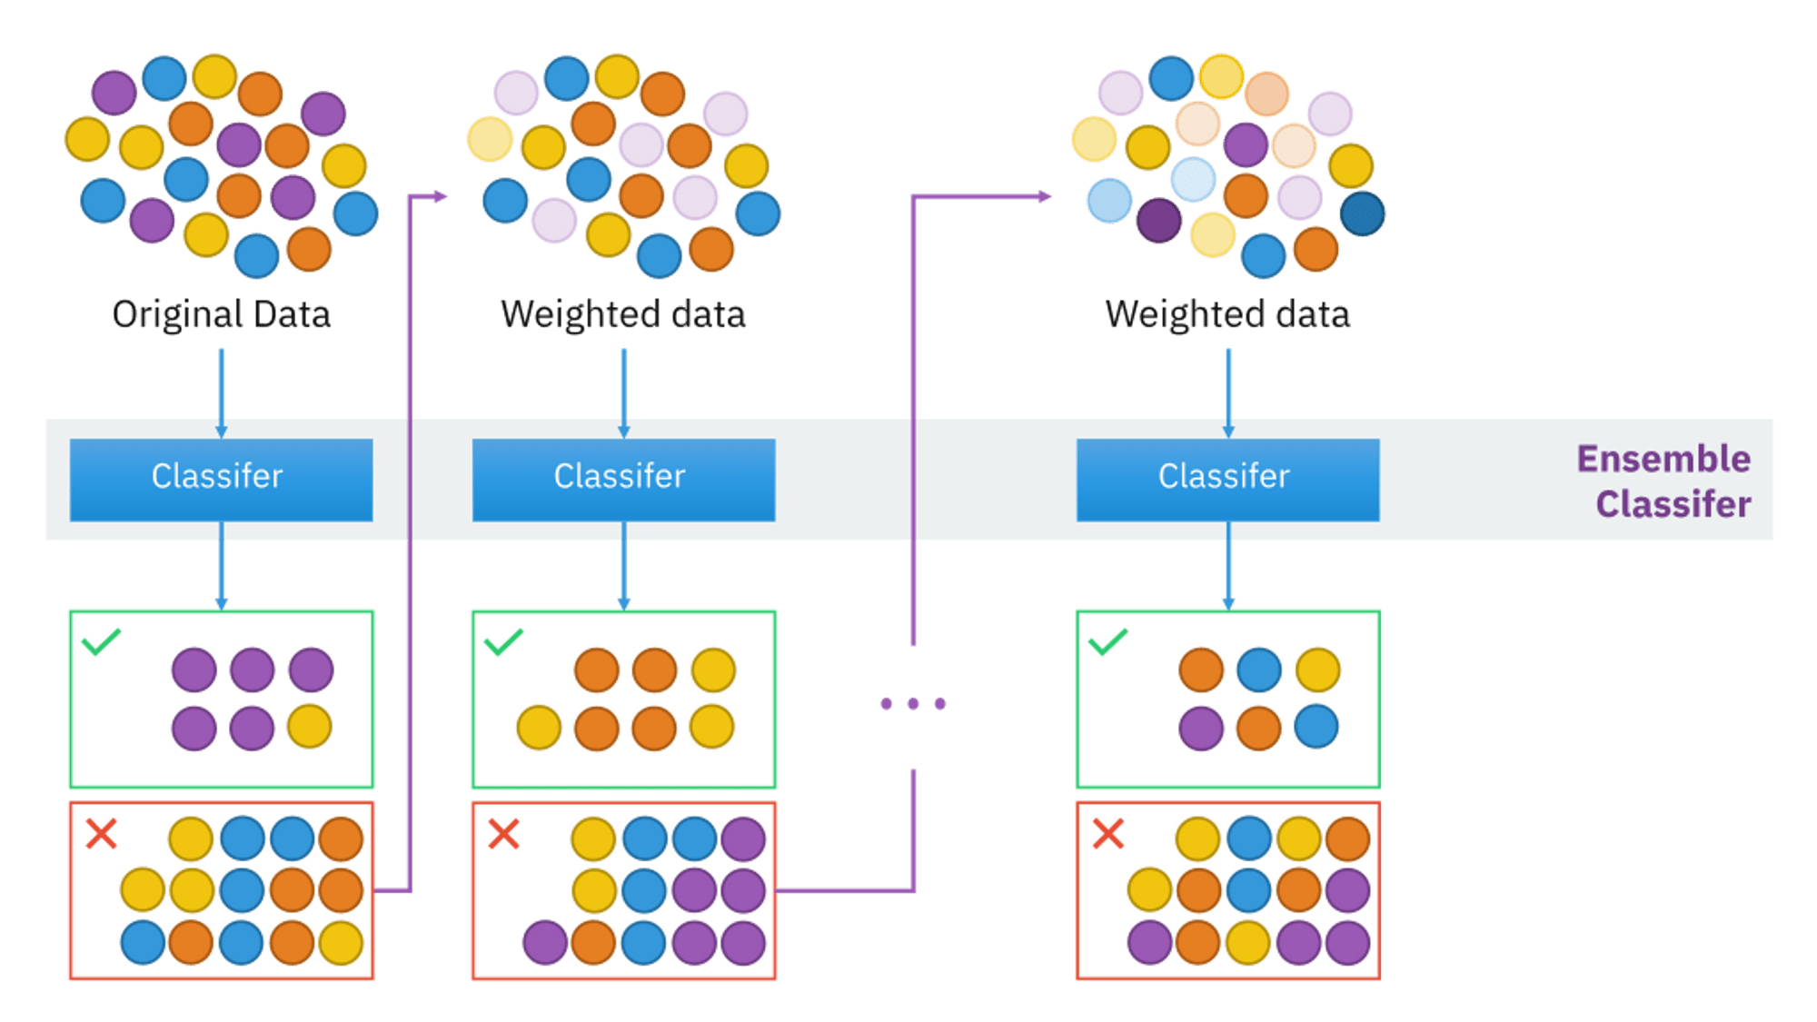
AdaBoost Algorithms

Slide 6
XG Boost Algorithms
XG Boost (eXtreme Gradient Boosting) is a popular supervised-learning algorithm used for regression and classification on large datasets.
It uses sequentially-built shallow decision trees to provide accurate results and a highly-scalable training method that avoids overfitting.

Slide 7
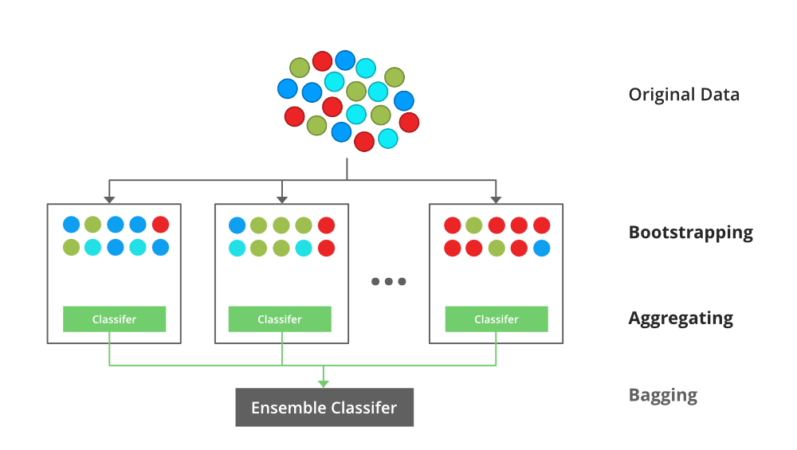
XG Boost Algorithms

Slide 8
LG Boost Algorithms
LightGBM is a gradient boosting ensemble method that is used by the Train Using AutoML tool and is based on decision trees.
It is optimized for high performance with distributed systems.
It is widely used in Python to handle large datasets, often outperforming other boosting algorithms in terms of speed and memory usage.

Slide 9
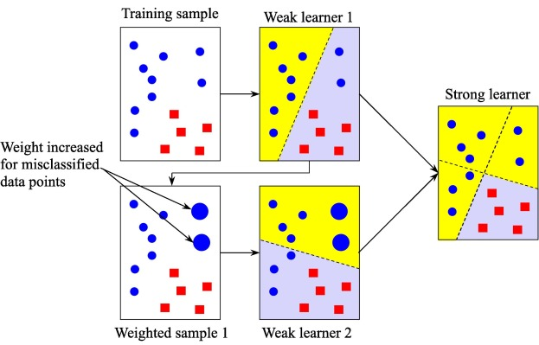
LG Boost Algorithms

Slide 10
Advantages
High accuracy
Handles complex data
Reduces bias & variance

Slide 11
Limitations
Can over fit
Slower training
Sensitive to noise

